Slide 1
Governance and Compliance

Slide 2
Management Group
Provide a level of scope above the subscriptions.
Benefits:
Organizational alignment for your azure subscription through custom hierarchies
Targeting of policies and spend budget across subscriptions and inheritance down the hierarchies
Compliance and cost reporting by organization

Slide 3
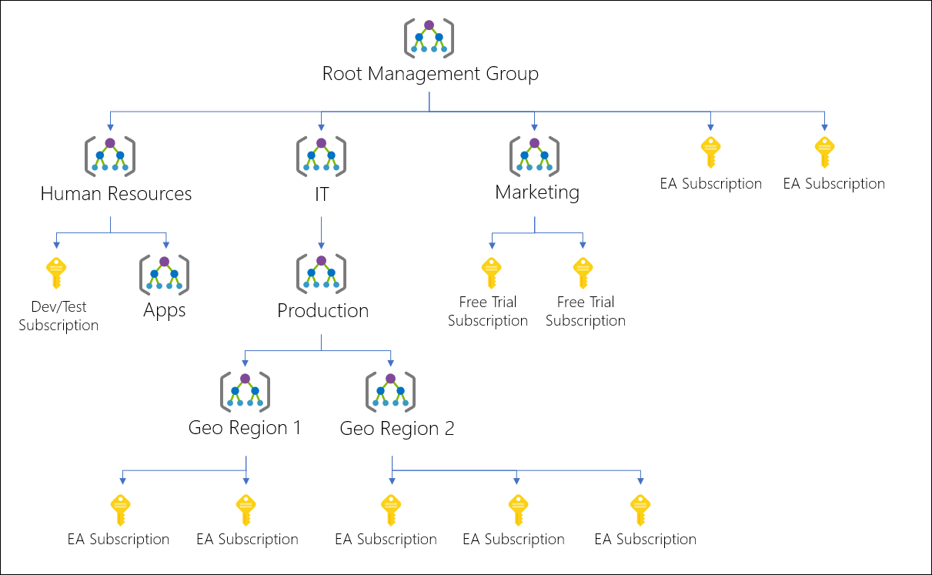



Slide 4
Azure Subscriptions
Azure subscription is a logical unit of Azure services that is linked to an Azure account.
Billing for Azure services is done on a per-subscription basis.
Users, groups and service principles
Azure resources in resource group
Authentication
& Authorization
Azure Subscriptions
Microsoft Entra ID
(Azure Active Directory)

Slide 5
Getting a Subscription
Enterprise Agreement – Upfront monetary commitment
Resellers – Open Licensing Program
Partners – Design and implement your Azure cloud solution
Personal
Free Trial
Pay-As-You-Go
Student
Azure Pass
MSDN

Slide 6
Check Resource Limit
Azure provides ability to see the number of each type of resource that you have deployed.
Track the current usage and plan for future use

Slide 7
Resource Tags
You can apply tags to your Azure resources to logically organize them by categories.
Each tag consists of a name and value.
Ex: Environment as Production
Use case of tags is to use it for grouping billing data
You can have upto 50 tag name/value pairs for each resource or resource group
Tags applied to the resource group are not inherited by the resources in that resource group

Slide 8
Tag Examples
Tag | Description
Location | Ex: eus, wus
Environment | Dev, Test, Stg, Prod
Owner | Owner of the resource
Cost Center | Cost Center
Department | Department name
Application Name | App team name
Maintenance Windows | Patching window

Slide 9
Cost Analysis
Get consolidated cost view
Actual utilization
Forecast based on current utilization
Budgets and Alerts
Cost Views
Cost by Resource

Slide 10
Azure Pricing Calculator
Provides estimates in all areas of Azure including compute, networking, storage, web and databases.
https://azure.microsoft.com/en-us/pricing/calculator/

Slide 11
Azure Policy

Slide 12
Azure Policy
It is a service that you can use to create, assign and manage policies.
Enforce different rules over your resources, so those resources stay compliant.

Slide 13
Policy Advantages
Enforcement and compliance
Apply policies at scale
Remediation

Slide 14
Implementing Azure Policy
Browse Policy Definitions – Ex: Allowing certain VM SKUs, Allowing certain locations
Create Initiative Definitions – Combine policies
Scope the Initiative Definition – Apply at Management Group, Subscription, Resource Group
View Policy Evaluation Results

Slide 15
Role Based Access Control

Slide 16
RBAC
Capability to grant appropriate access to Azure AD users, groups or service principles.
Select a Role
Common Roles:
Owner – Manage everything, including access
Contributor – Manage everything except access
Reader – View everything but cannot make changes

Slide 17

















Slide 18
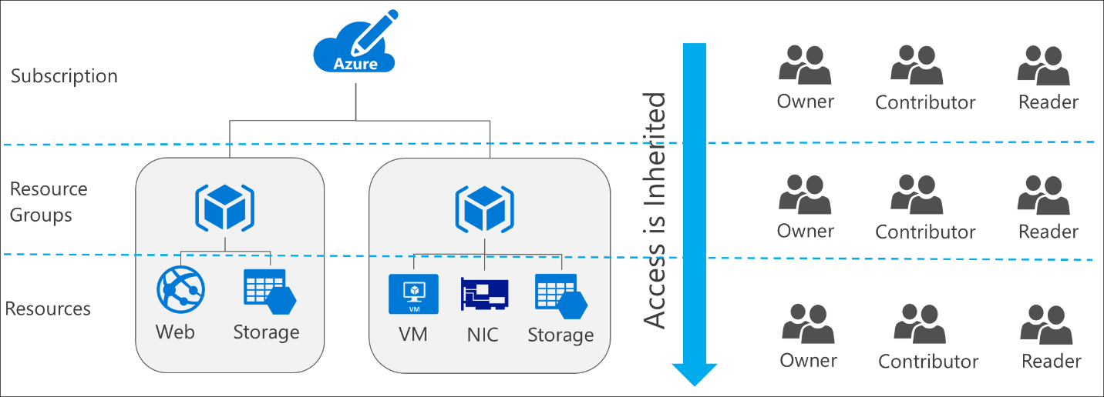








Slide 19








Slide 20
Users and Groups

Slide 21
User
Users who require access to resources must have a user account.
Types of Identities:
Cloud Identities – User that only exist in Azure AD Ex: Admin account
Directory-synchronized identities – Users brought into the Azure through a synchronization activity using Azure AD Connect.
Guest User – Users from outside Azure. Ex: abc@gmail.com

Slide 22
Group
Helps organize users to make it easier to manage permissions.
Two Types:
Security Group – Security Enabled and is used to assign the permissions.
Distribution Group – Used mainly by email applications and not security enabled.

Slide 23







Slide 24









